Slide 1
Ignite 2017 recap
Firstname Lastname
Get the latest version of this presentation from
http://bit.ly/Ignite2017Recap

Slide 2



Firstname Lastname Microsoft MVP Title | Company
@Twitter
firstname.lastname@company.com

Slide 3

Ignite 2017
What is it, and why should I care?

Slide 4
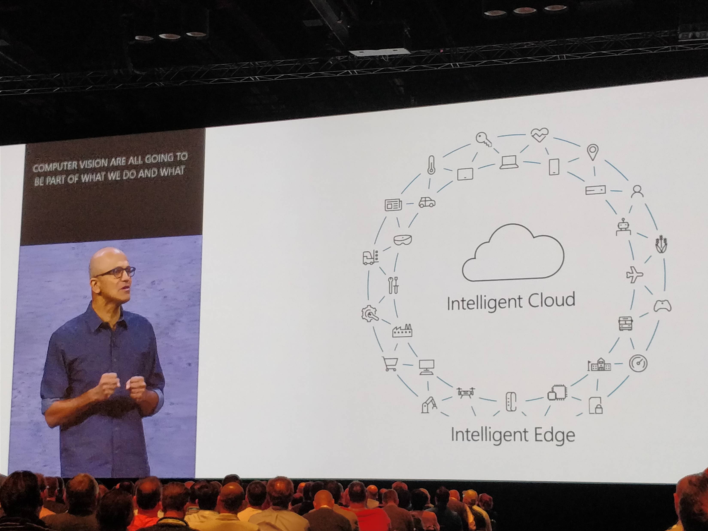
Largest Microsoft event of the year
Held in Orlando in late September
5 days, over 900 sessions representing all major Microsoft products and services
4 keynotes
Main keynote (Satya Nadella)
Modern Workplace (Kirk Koenigsbauer)
Business Applications (James Phillips)
The Enterprise Cloud (Scott Guthrie)
Over 24000 attendees
Session recordings and PowerPoints available through MyIgnite

Slide 5
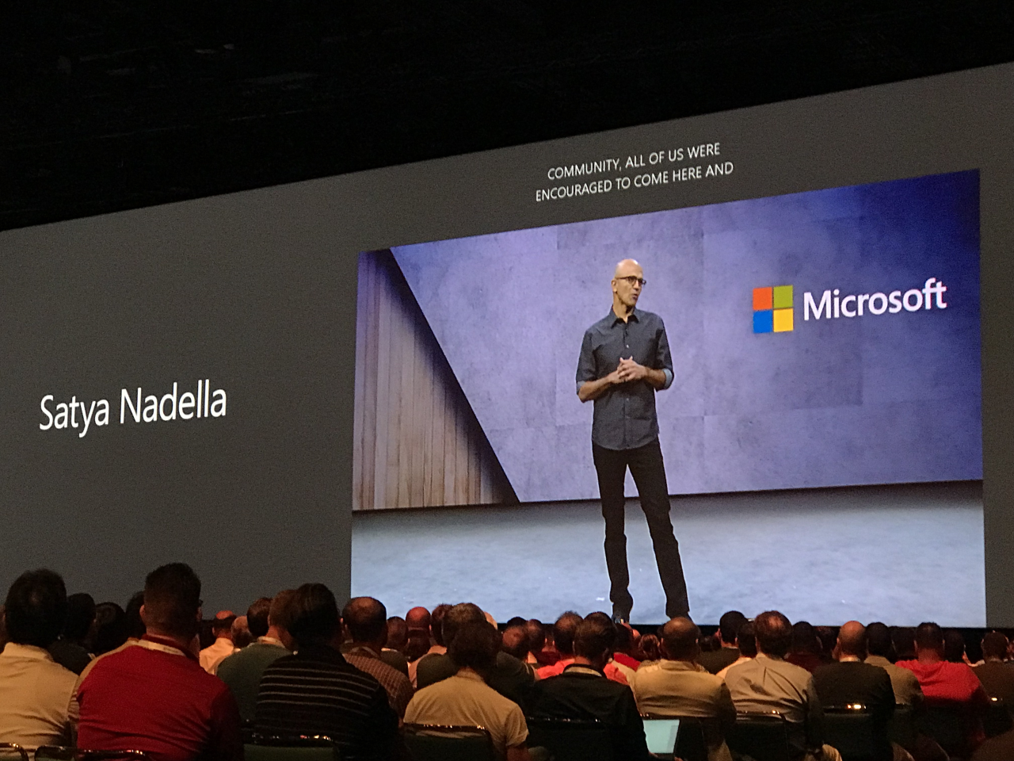
Microsoft Azure

Slide 6

Azure Stack
Generally available since September 25, 2017
Azure in your datacenter, for building hybrid cloud environments
Integrated systems available from Dell EMC, Hewlett Packard Enterprise and Lenovo
Avanade provides a fully managed solution
https://www.avanade.com/en/technologies/azure-stack
New certification exam for Azure Stack Operators
https://azure.microsoft.com/en-us/blog/why-your-team-needs-an-azure-stack-operator/
Azure Stack overview
https://azure.microsoft.com/en-us/overview/azure-stack/
Azure Stack Development Kit
https://docs.microsoft.com/en-us/azure/azure-stack/azure-stack-deploy-overview

Slide 7

Power BI Embedded
Generally available since October 3, 2017
Power BI Embedded is a scalable and managed service for application developers to embed interactive reports and dashboard into apps
Available in 3 SKUs
EM, A and Premium
EM has fixed pricing based on capacity with limitations
A has per hour pricing with less limitations
Premium has fixed pricing capacity, with everything included that EM and A have
Pricing
https://azure.microsoft.com/en-us/pricing/details/power-bi-embedded/
Documentation
https://docs.microsoft.com/en-us/azure/power-bi-embedded/
Notes:
Additional information: https://whitepages.unlimitedviz.com/2017/09/understanding-the-power-bi-capacity-based-skus/

Slide 8

SQL Server 2017 in Azure VM: Linux & Windows
Generally available since October 2, 2017
SQL Server 2017 (RTM) images for Linux and Windows available on Azure Marketplace
Supports Windows, Red Hat Enterprise Linux, SUSE Enterprise and Ubuntu
Additional licensing, pricing and overview decks
https://azure.microsoft.com/en-us/services/virtual-machines/sql-server/
SQL Server 2017 on Azure VMs (Linux)
https://docs.microsoft.com/en-us/azure/virtual-machines/linux/sql/sql-server-linux-virtual-machines-overview
SQL Server 2017 on Azure VMs (Windows)
https://docs.microsoft.com/en-us/azure/virtual-machines/windows/sql/virtual-machines-windows-sql-server-iaas-overview
Notes:
Announcement: http://bit.ly/sql2017vm

Slide 9

End-to-end monitoring in Azure for apps and infrastructure
Released in September 25, 2017
Azure Monitor offers a public preview of unified overview
Combines alerts, Application Insights and Log Analytics views and alerts
Azure Monitor also provides near real-time alerting in public preview
New metrics and logs from different Azure services now surface in Azure Monitor
Many monitoring enhancements to Log Analytics and Application Insights,
Azure Monitor
https://docs.microsoft.com/en-us/azure/monitoring-and-diagnostics/monitoring-near-real-time-metric-alerts
Application Insights
https://docs.microsoft.com/en-us/azure/application-insights/
Notes:
Supported metrics with Azure Monitor: https://docs.microsoft.com/en-us/azure/monitoring-and-diagnostics/monitoring-supported-metrics

Slide 10
Azure Availability Zones
Preview released September 21, 2017
Availability Zones provide fault-isolated locations within an Azure region
Supports Linux/Windows VMs, Managed Disks, Load Balancer and Zonal VM Scale Sets
Av2, Dv2 and DSv2 VM families supported
Available during preview in East US 2 (Virginia) and West Europe (Netherlands)
Overview of Availability Zones
https://docs.microsoft.com/en-us/azure/availability-zones/az-overview
Sign up for Availability Zones preview
http://aka.ms/az

Slide 11
Azure Cost Management
Based on the Cloudyn acquisition, available since September 25, 2017
Azure Cost Management helps managing and optimizing cloud spend for Azure, AWS and Google Cloud Platform
Free for Azure customers
AWS and Google Cloud Platform cost is 1% of the managed cloud spent
Used to visualize cloud usage and costs, and to provide operational and financial insights into spending
Must be activated per subscription through Azure Portal
Overview of Azure Cost Management
https://azure.microsoft.com/en-us/services/cost-management/
Getting started with Azure Cost Management
https://docs.microsoft.com/en-us/azure/cost-management/overview

Slide 12
Azure Security Center updates
Available since September 25, 2017
Azure Security Center unifies security management across environments
Onboarding VMs and computers in on-premises (and other clouds) is supported through Microsoft Monitoring Agent
Azure Policy now in limited preview for setting Security Center policies across multiple subscriptions
Windows Defender Advanced Threat Protection is soon included in detections
New Investigation Experience in preview
Adaptive application controls in limited preview
Logic Apps-based security playbooks for automation
Many other enhancements and features
Security Center documentation
https://docs.microsoft.com/en-us/azure/security-center/
Onboard to Azure Security Center
https://docs.microsoft.com/en-us/azure/security-center/security-center-onboarding
Azure Policy
https://azure.microsoft.com/en-us/services/azure-policy/

Slide 13
PowerShell in Azure Cloud Shell
Public preview available since September 25, 2017
Cloud Shell in Azure Portal gets PowerShell support
Previously only Bash was available
Extensible through PowerShell Gallery
https://www.powershellgallery.com/
Also available in Azure Mobile App
https://azure.microsoft.com/en-us/features/azure-portal/mobile-app/
Cloud Shell overview
https://docs.microsoft.com/en-us/azure/cloud-shell/overview
Azure PowerShell overview
https://docs.microsoft.com/en-us/powershell/azure/overview

Slide 14
New automation and configuration capabilities in Azure Portal
Available since September 25, 2017
Azure VM integration allows update management, inventory and change tracking from Azure Portal VM blade
Management at scale of VMs through Automation & Configuration service
Support for Python in runbooks
Azure Automation documentation
https://docs.microsoft.com/en-us/azure/automation/
Pricing
https://azure.microsoft.com/en-us/pricing/details/automation/

Slide 15
Azure Database Migration Service and Azure SQL Managed Instance
In limited preview
Azure Database Migration Services will help you migrate from on-premises databases to Azure SQL databases
Support for SQL Server, Oracle and MySQL as source
Azure SQL Database – Managed Instance brings better compatibility with on-premises SQL Server, and new isolation features
Network isolation (VNET), private IP support
Public preview coming soon
Sign up for limited previews
https://sqldatabase-migrationpreview.azurewebsites.net/

Slide 16
New tools for Artificial Intelligence (AI)
Available since September 25, 2017
Azure Machine Learning Workbench is a cross-platform client for data wrangling and experiment management
Azure Machine Learning Experimentation Service for experimenting with big data and GPUs
Azure Machine Learning Management Service to host and manage machine learning models
Deep dive to Azure Machine Learning
https://azure.microsoft.com/en-us/blog/diving-deep-into-what-s-new-with-azure-machine-learning/

Slide 17
New tools for Artificial Intelligence (AI)
Available since September 25, 2017
Visual Studio Code tools for AI released
Microsoft Cognitive Services get two new updates
Text analytics
Bing Custom Search (GA in October)
Dynamics 365 AI Solutions introduced
Visual Studio Code Tools for AI
https://www.visualstudio.com/downloads/ai-tools/
Dynamics 365 AI Solutions intro
https://www.microsoft.com/en-us/AI/ai-solutions

Slide 18
Azure core infrastructure updates
Available since September 25, 2017
New VM sizes
M-Series: Purpose-built infrastructure
B-Series: Burstable workloads
Upcoming: Fv2, NCv2, ND series
Preview for Azure File Sync, secure & centralized file shares in the cloud
Azure DDoS Protection preview that automatically applies traffic scrubbing
Preview for Azure Data Box, for transferring large datasets to Azure
Preview for Azure Migrate service for capturing and mapping migration needs from on-premises to Azure
Azure DDoS
https://azure.microsoft.com/en-us/services/ddos-protection/
Azure File Sync
https://docs.microsoft.com/en-us/azure/storage/files/storage-sync-files-deployment-guide
Azure B-Series VMs
https://azure.microsoft.com/en-us/blog/introducing-b-series-our-new-burstable-vm-size/
Azure Migrate
https://azure.microsoft.com/en-us/solutions/cloud-migration/
Azure Data Box
https://azure.microsoft.com/en-us/blog/announcing-the-preview-for-the-azure-data-box-achievements-will-be-unlocked/

Slide 19
Azure Active Directory Pass-through Authentication
General availability since September 29, 2017
Partially replaces ADFS-infrastructure for federated identities
Provides seamless single sign-on for users, typically for Office 365 and similar workloads
Uses Azure AD Application Proxy to expose HTTPS endpoint for authentication
Azure AD Pass-through Authentication
https://docs.microsoft.com/en-us/azure/active-directory/connect/active-directory-aadconnect-pass-through-authentication
Technical Deep Dive
https://docs.microsoft.com/en-us/azure/active-directory/connect/active-directory-aadconnect-pass-through-authentication-how-it-works

Slide 20
Get all Ignite 2017 recap presentations
http://bit.ly/Ignite2017Recap

